Slide 1

CENTRAL HEALTHCARE
SYSTEM
Raghav Jindal - 18BCE2080
Nimish Batra - 18BCE2087

Slide 2

ABSTRACT
Due to the rapid increase in population and because of people’s unhealthy lifestyle the number of
patients have been increasing by the day due to which all the hospitals are flooded and have low
availability at times. Also because of frequent waves of the COVID-19 hospitals have been
frequently running out of beds.Thus we propose a Central healthcare system aimed to provide
premier superior quality services. We propose a method to solve the crisis of an emergency
remote system and unavailability of a proper centralised system for medicine information . We
are also adding a face - recognition login and aadhar verification to prevent identity theft and
misuse. To solve emergency remote problems we are making a doctor chatbot and if the query is
not solved by the chatbot then we will be re-directing the patient to chat directly with the
doctor and further we will also be adding an emergency button that will help the patient to reach
hospital at earliest. For medicinal information we will be scanning the doctor’s prescription and
will show you the results from where you can purchase it online and all the information about it
including its alternative and we will be adding a reminder for doses through google’s calendar.

Slide 3
OBJECTIVE
1. Our primary objective is to provide a central healthcare system which would avoid
last minute chaos due to low or no availability.
1. Our second objective is providing a face-recognition login and aadhar verification
that would help us in preventing identity theft and misuse of people’s personal
information.
1. Thirdly, we are going to provide a chatbot service. This service will be provided to
all the patients at the first step. The patient can put up their problem in front of
the chatbot and then the chatbot will provide them with the solution. In case the
chatbot cannot provide the solution or the patient is not satisfied with the solution
they can move forward to chat directly with the doctor.

Slide 4
OBJECTIVE
4. The fourth objective is to help patients reach the nearest hospital at the earliest, this
will be possible by sending an alert to the nearby ambulance and its driver to reach the
patients location. The driver will receive the alert through SMS and he will get to know
the patient's location, phone number and his Aadhar card number.
5. The last objective is to help people get medicines. At times people even face difficulty
in reading the doctor’s handwriting so our web application will help the patient recognize
the name of the medicine and the places from where it can be bought online. If the
medicine is out of stock the patient will even get to know the salts in the medicine and
hence the alternatives available. The patient can set the dosage in google calendar the
web app will remind them to have their medicine on time by using google calendar.

Slide 5

In today’s time of crisis and during rising
cases of the COVID-19 hospitals have
become really crowded and patients and
their families are at the suffering end. To
automate the process and to help patients
know about the status of availability and to
help them with medicinal information we are
creating this centralized healthcare system
so as to save people’s time and the lives of
their loved ones. We will be using natural
INTRODUCTION
language
blockchain and a few more technologies to
get this project up and running.
processing,
Web
scraping,

Slide 6
Unavailability of beds and proper medical
aid in hospitals.
Lack of proper guidance by medical staff
due to less number of doctors being
PROBLEM STATEMENT- available.
Patients not being able to reach hospital in
time.
Patients not able to recognize the correct
medicine or not able to know which
alternative to buy incase of unavailability of
that particular medicine which has been
prescribed
by
the
doctor.

Slide 7

PROPOSED
SOLUTION
We will be making a web application to solve the problem of the centralised health care system.
We propose a method to solve the crisis of an emergency remote system and unavailability of a
proper centralised system for medicine information . We are also adding a face - recognition
login and aadhar verification to prevent identity theft and misuse. To solve emergency remote
problems we are making a doctor chatbot and if the query is not solved by the chatbot then we
will be re-directing the patient to chat directly with the doctor and further we will also be
adding an emergency button that will help the patient to reach hospital at earliest which when
clicked will send an alert message to the nearest hospital and to the nearest ambulance . For
medicinal information we will be scanning the doctor’s prescription and will show you the results
from where you can purchase it online and all the information about it including its alternative
and we will be adding a reminder for doses through google’s calendar .

Slide 8
METHODOLOGY
TECHNIQUES
Technology Stack -
1. Flask
2. Dialog Flow
1. Natural Language Processing
2. Machine Learning
3. Web Scraping
4. Database Management
5. Computer Vision
3. Google Maps API Integration
4. Google Vision
5. Node Js
6. Python
7. Python libraries like OpenCV,
pandas, numpy, etc
8. PHP
6. Blockchain
9. SQL

Slide 9
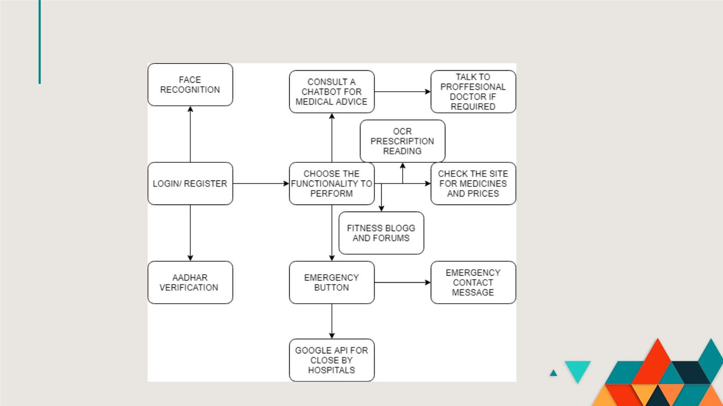
ARCHITECTURAL DIAGRAM

Slide 10
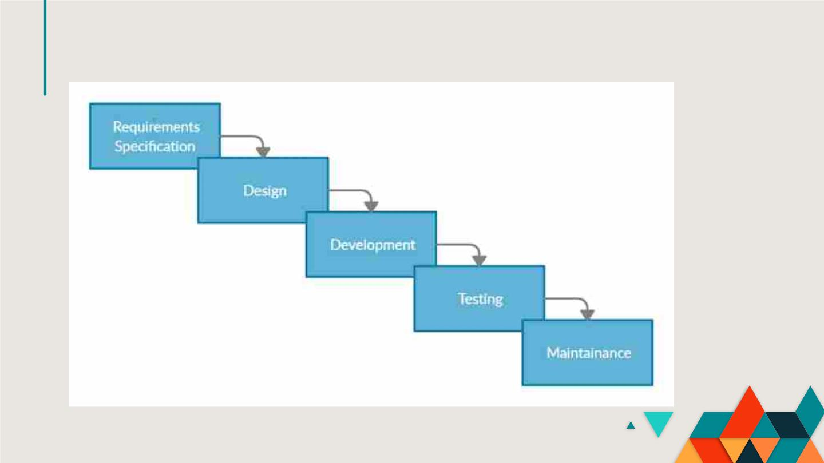
SOFTWARE DEVELOPMENT DIAGRAM

Slide 11

HOW IS OUR PRODUCT BETTER THAN THE EXISTING PRODUCTS?
How is our product better than the existing products?
Our product is providing everything under one roof. There are many products in the market providing most of our services but individually or
with lesser or complex features. Starting with our login module the facial recognition library being used by us only requires 1 photo whereas
other products in the market require more than 100 photos per person to train the module properly, which is more of a traditional method.
The aadhar OCR that we are using no such open source system exists. One of the most common competitors of our chatbot is rasa nlu, and even
a few more traditional training based chatbots but the biggest problem with these is they are not useful for particular domain related work. Our
chatbot allows the patient or its family member to talk and get a solution and if they aren’t satisfied they can even get to talk to a doctor and get
the desired medication or cure.Rasa
The prescription OCR that has been made by us no such open source system exists. Incase of OCR we have used google vision API and we find
our
competitor
to
be
pytesseract.
Our main reason behind choosing google vision was its speed, google vision is much faster than pytesseract and its even much more
accurate.Coming onto the part where scanning happens in case of pytesseract some of the unwanted elements are scanned whereas in case of
google vision no more unwanted elements are recognized.

Slide 12
Literature Survey
[1]Optical Character Recognition (OCR) is a piece of software that converts printed text and images into digitized form such that it can
be manipulated by machine.Unlike human brain which has the capability to very easily recognize the text/ characters from an image,
machines are not intelligent enough to perceive the information available in image. Therefore, a large number of research efforts have
been put forward that attempts to transform a document image to format understandable for machine.OCR is a complex problem because
of the variety of languages, fonts and styles in which text can be written,and the complex rules of languages etc. Acquisition, Pre-
processing, Segmentation, Feature extraction, classification are being used.
[2]Optical character recognition is an active research area that attempts to develop a computer system with the ability to extract text from
images automatically. The objective of OCR is to achieve modification or conversion of any form of text or text-containing documents. In
this paper we investigate OCR in four different ways. We give a detailed overview of the challenges that might emerge in the state-of-the-
art of the field. We highlight developments and main applications and uses of OCR. A brief OCR history is also discussed. The paper
provides a comprehensive review of the state of the art of the OCR field. Google Goggles is an Image Detection System which identifies
the content of an image and provides desired results to the user. It also uses Tesseract OCR to detect textual data in images and extracts
the text into editable format. But, one of the limitations of Goggles is that it isn’t able to classify the data present, and considers it to
be in raw form. Optical Character Recognition (OCR) is used in converting PDF files into editable DOC files.

Slide 13
Literature Survey
[3]Due to the increased precision of the systems involved in the framework, the use of multimodal inputs in a smart healthcare framework
is promising. We propose a user satisfaction detection system in this paper that uses two multimedia contents: speech and image.
Satisfied, dissatisfied, and indifferent are the three levels of satisfaction. The user's speech and facial image are captured, transmitted to
the cloud, and then analysed in the proposed system. The relevant stakeholders are then informed of the satisfaction decision. The cloud is
used to extract some features from these two inputs. Multimodal input signals are processed, namely, speech and image signals. A
microphone records the speech from the user while a video camera captures the facial expressions
[4]To extract textual data from images & automate the process of storing contact details and storing reminders. Extraction of text and
other forms of data from images and using them for particular use. To extract URLs from the image and allow user to browse directly
from the app using Android System Web View. Using computer vision (Pytesseract) to extract useful information like text, contact details
and hyperlinks from images. The android based app would allow users to enable storing the contact details, provide summary of the
content ,opening of links directly from the app without needing to type the URL inside the browser. Optical Character Recognition (OCR)
is used in converting PDF files into editable DOC files. Another limitation is that the text present in images of PDF files aren’t extracted
into editable format.

Slide 14
Literature Survey
[5]The optical person acknowledgment (OCR) technique has been utilized in changing overprinted text into editable text. OCR is an
extremely helpful and well-known strategy in different applications. The precision of OCR can be reliant upon text preprocessing and
division calculations. From the vehicle number plate they attempted to remove vehicle numbers by utilizing Tesseract and Transym. A
picture with the text is given as contribution to the TesseRact motor that is order based tool.Then it is handled by Tesseract order as
Tesseract order takes two contentions: First contention is picture record name that contains text and second contention is yield text
document in which removed text is put away. The result record expansion is given as .txt by Tesseract, so no compelling reason to
indicate the document augmentation while determining the result document name as a second contention in the Tesseract order
[6] Computerized Drug Verification System (CDVS) is a research work geared towards establishing the means of identifying authentic
drugs in Nigeria. The project is based on the National Agency for Food and Drug Administration Control (NAFDAC) number. The app
can be used to verify the authenticity of drugs in the country in partnership with Mobile authentication Service (MAS) . Using a mobile
app NAFDAC VERIFY drug verification shall take place and it works on both iOS and android.

Slide 15
Literature Survey
[7] Blockchain technology is leveraging its innovative potential in various sectors. Research interest has focused on medical and health
care applications. However, knowledge about the impact on the healthcare ecosystem is limited.This paper explores a potential Paradigm
shift And ecosystem Evolution in health Care utilizing blockchain technology. A literature review with case study on a pioneering
initiative was conducted and along with a systematic life cycle analysis, this study sheds light on the evolutionary development of
blockchain in health care scenarios and its interactive relationship among stakeholders
[8] Transfer Learning, where a model is first pre-prepared on an information-rich assignment before being adjusted on a downstream
undertaking, has risen as an amazing method in common language handling (NLP). The adequacy of move learning has offered an ascend
to a variety of approaches, system, and practice. In this paper, we investigate the scene of move learning methods for NLP by presenting a
bound together structure that changes over all content based language issues into a book-to-message design. Our precise investigation
analyzes pre-preparing goals, models, unlabeled informational indexes, move draws near, and different components on many language
getting undertakings. By consolidating the bits of knowledge from our investigation with scale and our new ''Colossal Clean Crawled
Corpus'', we accomplish cutting edge results on numerous benchmarks covering rundown, question replying, text order, and that's just the
beginning. To encourage future work on move learning for NLP, we discharge our informational collection, pre-prepared models, and
code.

Slide 16
Literature Survey
[9] 30% of inspected drug stores in 2003 were found with substandard / spurious/ falsely-labeled/ falsified/
counterfeit drugs. The economic burden on the population drug expenditures and on governments is high. This
study aims to develop a pharmacy surveillance blockchain system and test its functions. Using Distributed
Application (DApp) that will run on smart contracts, employing Swarm as the Distributed File System (DFS)
[10] Not at all like late language portrayal models, BERT is intended to pre-train profound bidirectional
portrayals from unlabeled content by mutually molding on both left and right settings in all layers.
Accordingly, the pre-prepared BERT model can be adjusted with only one extra yield layer to make
cutting edge models for a wide scope of undertakings, for example, question noting and language
derivation, without significant errand explicit design changes. BERT is adroitly basic and exactly
incredible. It acquires new best in class results on eleven normal language handling undertakings,
including pushing the GLUE score to 80.5% (7.7% point supreme improvement), MultiNLI exactness to
86.7% (4.6% outright improvement), SQuAD v1.1 question noting Test F1 to 93.2 (1.5 point total
improvement) and SQuAD v2.0 Test F1 to 83.1

Slide 17
Literature Survey
[11]Convolutional networks are at the center of most cutting edge PC vision answers for a wide
assortment of assignments. Albeit expanded model size and computational cost will in general mean
quick quality increases for most errands (as long as enough marked information is accommodated
preparing), computational proficiency and low boundary tally are as yet empowering factors for
different use cases, for example, versatile vision and enormous information situations. Here we are
investigating approaches to scale up networks in manners that target using the additional calculation
as effectively as conceivable by appropriately factorized convolutions and forceful regularization. We
benchmark our strategies on the ILSVRC 2012 grouping challenge approval set show significant
increases over the best in class: 21.2% top-1 and 5.6% top-5 mistake for single edge assessment
utilizing an organization with a computational expense of 5 billion duplicate includes per surmising and
with utilizing under 25 million boundaries. With a troupe of 4 models and multi-crop assessment, we
report 3.5% top-5 blunder and 17.3%.
[12] There are several areas of healthcare that could be enhanced using blockchain technologies.
These include device tracking, clinical trials, pharmaceutical tracing, and health insurance. The
information gathered can then be used to improve patient safety. Usage of patient records, drug
tracking and device tracking

Slide 18
Literature Survey
[13This study presents a systematic literature review (SLR) of research on blockchain applications in the healthcare
domain. Findings indicate that blockchain is being used to develop novel and advanced interventions to improve
standards of handling, sharing, and processing of medical data and personal health records.SLRs offer readers
comprehensive knowledge of the literature in a field through a holistic and organized précis that adheres to standard
protocols. The current study adapted protocols which synthesized article assessment criteria from previously
published SLRs. The SLR protocol consisted of three main phases, namely planning, execution, and reporting
assimilated information.
[14] Attention is an undeniably mainstream instrument utilized in a wide scope of neural designs. The component itself
has been acknowledged in an assortment of configurations. In any case, in light of the relentless advances in this area,
an efficient outline of consideration is as yet absent. In this article, we characterize a bound together model for
consideration structures in characteristic language handling, with an emphasis on those intended to work with vector
portrayals of the printed information. We propose a scientific categorization of consideration models as indicated by
four measurements: the portrayal of the info, the similarity work, the appropriation work, and the assortment of the
information or potentially yield. We present the instances of how earlier data can be misused in consideration models
and talk about progressing research endeavors and open difficulties in the territory, giving the primary broad
classification of the huge group of writing in this energizing area

Slide 19
Literature Survey
[13This study presents a systematic literature review (SLR) of research on blockchain applications in the healthcare
domain. Findings indicate that blockchain is being used to develop novel and advanced interventions to improve
standards of handling, sharing, and processing of medical data and personal health records.SLRs offer readers
comprehensive knowledge of the literature in a field through a holistic and organized précis that adheres to standard
protocols. The current study adapted protocols which synthesized article assessment criteria from previously
published SLRs. The SLR protocol consisted of three main phases, namely planning, execution, and reporting
assimilated information.
[14] Attention is an undeniably mainstream instrument utilized in a wide scope of neural designs. The component itself
has been acknowledged in an assortment of configurations. In any case, in light of the relentless advances in this area,
an efficient outline of consideration is as yet absent. In this article, we characterize a bound together model for
consideration structures in characteristic language handling, with an emphasis on those intended to work with vector
portrayals of the printed information. We propose a scientific categorization of consideration models as indicated by
four measurements: the portrayal of the info, the similarity work, the appropriation work, and the assortment of the
information or potentially yield. We present the instances of how earlier data can be misused in consideration models
and talk about progressing research endeavors and open difficulties in the territory, giving the primary broad
classification of the huge group of writing in this energizing area

Slide 20
Literature Survey
[15] As we offer and store information on the web, another issue emerges is how to deal with such information over-burden and how the
client will get or get to the best data in the least endeavors. To illuminate these issues, specialists spotout new methods called Web
Scraping. Web scratching is an extremely basic method which is utilized to produce organized information based on accessible
unstructured information on the web. Scaping produced organized information at that point put away in a focal data set and investigated
in spreadsheets. Customary reorder, Text graping and ordinary articulation coordinating, HTTP programming, HTML parsing, DOM
parsing, Web scratching programming, Vertical accumulation stages, Semantic explanation perceiving and Computer vision website page
analyzers are a portion of the regular strategies utilized for information scratching. Presently, there are bunches of programming
accessible in the market for web scratching. Our paper is centered around the review on the data extraction procedure for example web
scratching, various procedures of web scratching and a portion of the ongoing devices utilized for a web scraping.
[16] Proposed idea is to create a medical chatbot using Artificial Intelligence. Both can diagnose the disease and provide basic
details about the disease before consulting a doctor. Certain chatbots act as medical reference books, which helps the patient
know more about their disease. Artificial intelligence chatbots are available 24*7, faster service cost savings but might require
regular maintenance

Slide 21
Literature Survey
[17] The increasing availability of electronic health data presents a major opportunity in healthcare.
Machine learning (ML) can transform patient risk stratification broadly in the field of medicine. This
could lead to targeted interventions that reduce the spread of health-care-associated pathogens.
Introduction of ML, how ML can transform healthcare epidemiology.
[18] Any E-Commerce firm to survive must be of cutting edge and competitive edge. Web content
mining enables them to attract and retain innumerable customers. The huge gap between Partial and
exhaustive promotion when it comes to the deployment of web mining techniques. The results show
that the model suits the economics behind the online businesses in both cases and thus helps to
identify or enhance the underlying web mining techniques towards business success. The paper models
web mining as a Game in Cournot Model to understand the varying role of web mining in online business
successes. It also shows that there are two distinct types of online business based on web content
promoted towards buy. Web usage mining and web content mining have been used.

Slide 22
Literature Survey
[19] The paper here explains the modeling and performance in deep learning computation for an
Assistant Conversational Agent (Chatbot) The model is developed to perform English to English
translation. experiments are conducted using Tensorflow using python 3.6. The paper here also
studies MacBook Air as a system for neural network and deep learning. Bidirectional Recurrent
Neural Network has been used
[20] Decreases in establishment and capacity costs have expanded the interest for security
frameworks, including video reconnaissance and computerized confirmation. The video observation
frameworks, when checked by people, are dependent upon mistakes and are trying to scale.
Confirmation frameworks can approve somebody utilizing a secret word or a card from another client.
Facial acknowledgment calculations can settle this shortcoming by the traffic observing of referred
to people or interlopers just as for individual biometric confirmation. Thus, this paper assesses the
FaceNet approach utilizing the Labeled Faces in the Wild benchmark, just as assesses an AI strategy
known as support vector machine (SVM) for the classification of embedding generated using FaceNet
The recommended approach additionally models a constant facial acknowledgment framework
consolidating FaceNet and SVM, arriving at 90% of precision utilizing a medium webcam.

Slide 23
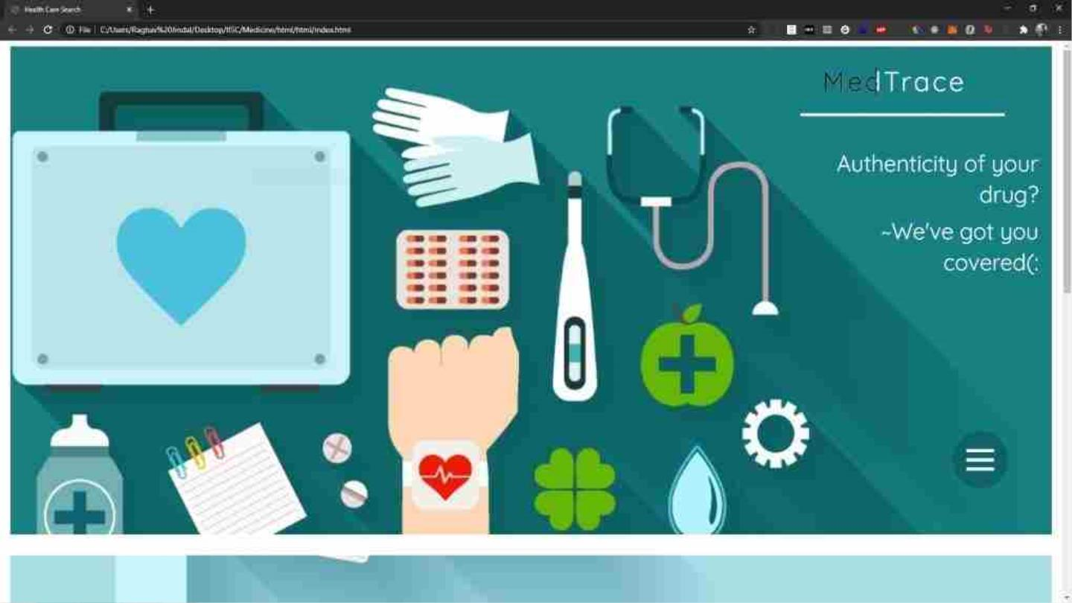

Slide 24
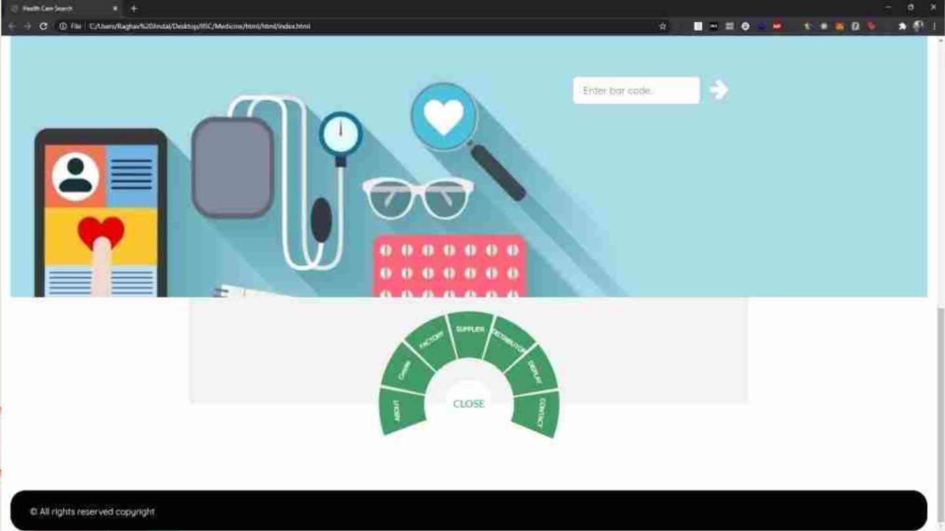

Slide 25
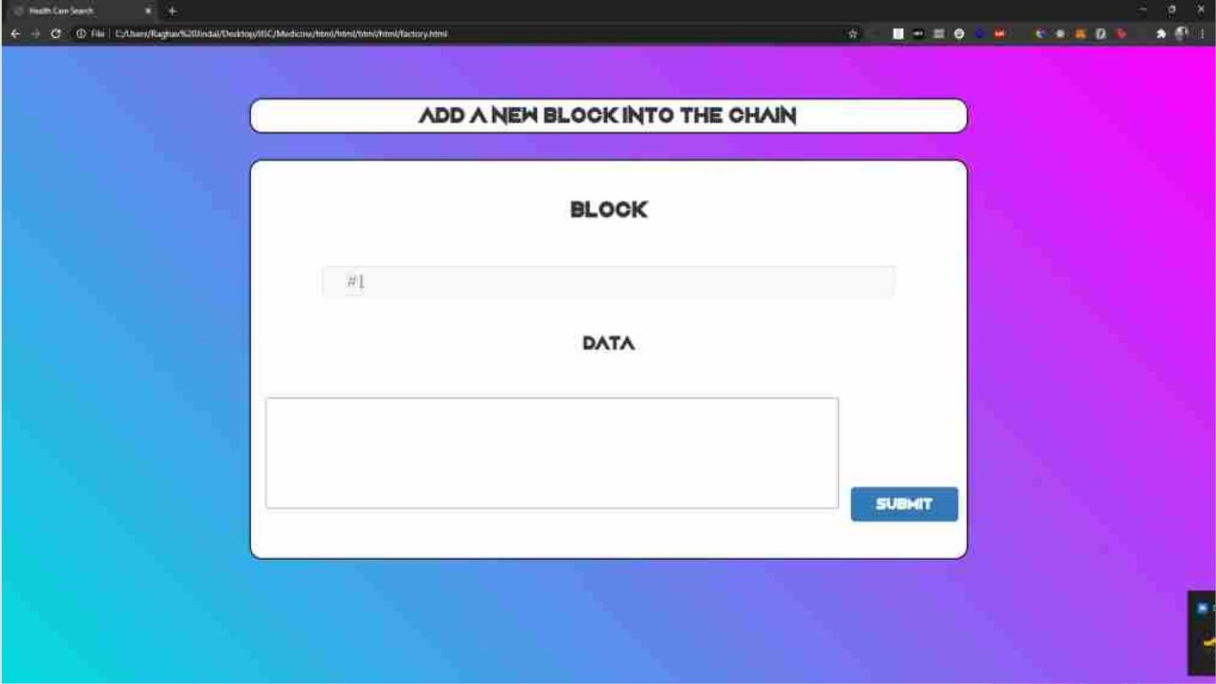

Slide 26
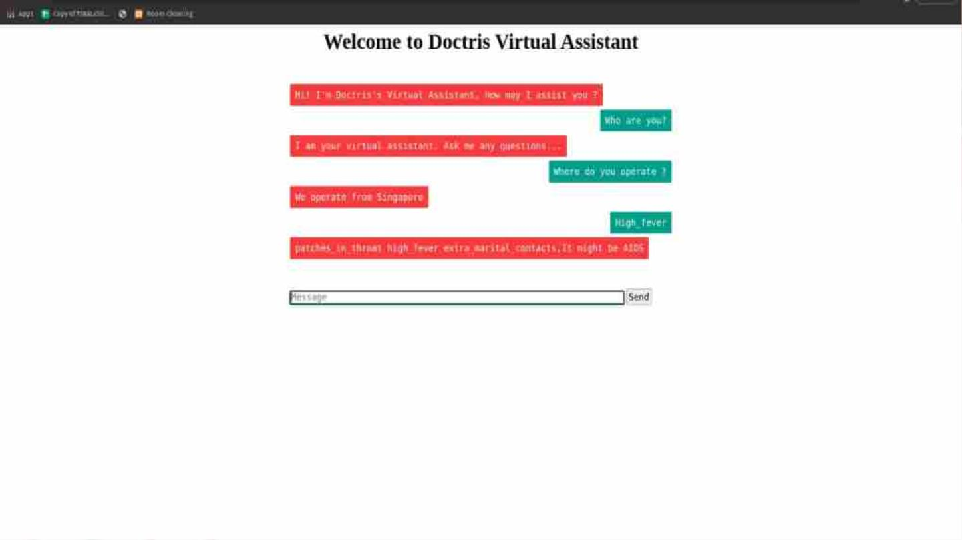

Slide 27
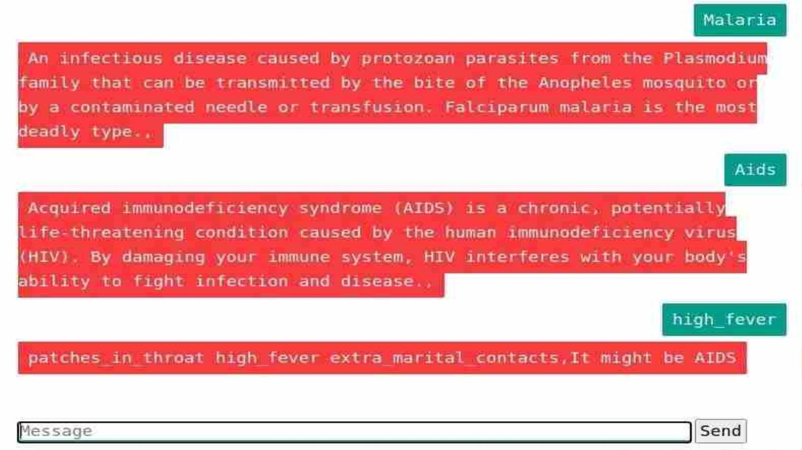

Slide 28
DEPLOYMENT OF MODULES
Login:
Modules used are Facial Recognition library (only requires 1 photo). Competitor: Traditional training methods (requires more than 100
photos to train per person) In this module when the user registers on our website, they take a snapshot of theirs. This snapshot is stored in
a folder named “data” where the snapshots of all our users are stored. Now when a user has to login into his account, he goes to the login
page. There he is asked to take a snapshot of his face. This snapshot is stored in a folder ”temp”. Now the program runs the face
recognition function and takes images of all the people who registered from the data folder and performs face encoding on each and
stores it in an array.
Then it takes the image in the temp folder and compares the image to each image in the data folder and finds the distance between them.
It stores the distance in another array. It sorts the array and finds the image with the minimum distance. If the distance is above a
threshold it returns the name of the user of whose image it is. If the username matches for the user who is attempting to log in, it allows
the person to complete the login and move into his account, else asks the person to try again or use the password.

Slide 29
DEPLOYMENT OF MODULES
Aadhar OCR: In this module, the user uploads their Aadhar card image and our system verifies the name and date of birth of the user
from the Aadhar card and the details provided. For detecting text, we have used Google-Vision API from Aadhar Card. For finding
Aadhar card we are using a regular expression to search for 12 digits number, for detection of the father’s name we are searching for the
keywords “C/O" or “D/O” or “S/O” as in Aadhar card the father’s name appears after that, for detection of address we are selecting all
the index from father’s name till we find the PIN CODE which can be found by searching 6 digit number, for date of birth we are
searching the particular format of the date that is present in Aadhar card like (dd/mm/yyyy).
Chatbot and Live Chat: : In this module, for chatbot, we have used chatterbot and for a live chat, we have used socket.io to talk
directly with the doctor. In chatbot, we have trained our data for symptoms of 40,000 diseases and have with the details of 41 diseases in
our SMS:
We are using this module to send SMS to the registered mobile numbers of users to inform them about any emergencies or information
regarding their health.
We are using the Twilio API to do so.

Slide 30
DEPLOYMENT OF MODULES
Web Scraping:
This module is being used to scrape data off a website to gather the information required to create a database. Over here we are scraping
the name of the medicine and its price in the Indian market to create a database for all the medicines present in India. This database
would then be used to create the e-commerce part of our project. Modules used here are requests and BeautifulSoup.
First, we open and read the website present and check for all the data that is required. We then check the source code. In the source code,
we check the data that is required and the HTML tags they are present in. Then using those tags we extract the required data.
Blockchain:
This module will help us to detect whether the medicines that we are getting are original or not, i.e, whether they are fake or expired and
have been restamped.
The value of this module represents: Fighting Drug Forgery, Data Integrity, Enhanced Traceability and Elevated compliance regulatory.

Slide 31
DEPLOYMENT OF MODULES
The procedure that ensues for drug traceability would be as followed:
1] The manufacturer marks the produced drug with a unique code and a hash is produced. This information is stored on the blockchain.
2] These drugs are then sent to the wholesaler
3] The drug is then verified by the manufacturers and this transaction is further stored in the blockchain.
4] The wholesaler sends the drugs to the pharmacist.
5] Further verification is carried out and this transaction is also stored in the blockchain.
6] From the pharmacist the drugs are then delivered to the patients.
7] The patient also verifies the origin of the drug and this transaction would also be stored in the blockchain.
Hospital API:
This API fetches data of Hospitals from different cities of India.
This API displays data like Id, State, City, Name, Category, Medicine, Address, Website, Specialization. We have developed a Django
Rest API for getting the list of hospitals and we have taken the data from data.gov.in which is an Indian government data website. This
API fetches data like city, state name of the hospital, medicine type, address, website and specialization of the hospital. This API can find
both the categories, private as well as public/ government hospitals. We have created an HTML form that takes the city name as an input
and uses it as a search parameter to find the hospital. We display the data in tabular form.

Slide 32
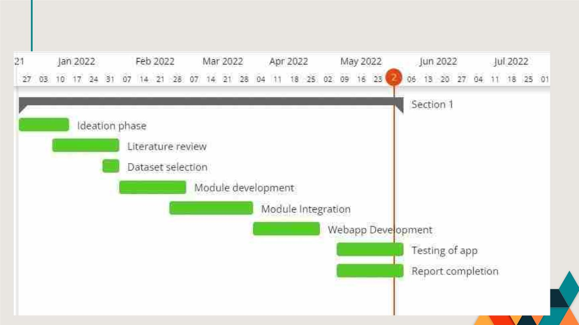
SCHEDULED TASKS AND MILESTONES

Slide 33
Results
We come across the following results with the help of the modules in order to successfully run this project.
Under the Aadhar OCR, once the user attempts to signs up with certain details such as user name, email ID,
Date Of Birth etc, these details are then further matched with the information available on their Aadhar card. If
it matches, then the user is able to sign up. The prescription OCR enables users to scan their own prescriptions
to find their medicines online and also look out for their substitutes based on the salt composition of the
prescribed medication. This will help them find out the alternatives of their medication in case of unavailability
of their prescribed medicines. The chatbot is set up with a trained data strength of 40,000 symptoms. It is able to
respond accurately to the 41 diseases it has been trained in. The ambulance button enables the user to send their
live location to the driver who can access and reach the user’s location easily. Blockchain helps us in preventing
drug forgery by verifying the source and origin of the drugs and whether they are suitable for consumption.

Slide 34
Conclusion
Our product is providing everything under one roof. There are many products in the market providing most of our services but
individually or with lesser or complex features. Starting with our login module the facial recognition library being used by us only
requires 1 photo whereas other products in the market require more than 100 photos per person to train the module properly, which
is
more
of
a
traditional
method.
The aadhar OCR that we are using no such open source system exists. One of the most common competitors of our chatbot is rasa
nlu, and even a few more traditional training based chatbots but the biggest problem with these is they are not useful for particular
domain related work. Our chatbot allows the patient or its family member to talk and get a solution and if they aren’t satisfied they
can even get to talk to a doctor and get the desired medication or cure.Rasa
The prescription OCR that has been made by us no such open source system exists. Incase of OCR we have used google vision API and
we
find
our
competitor
to
be
pytesseract.
Our main reason behind choosing google vision was its speed, google vision is much faster than pytesseract and its even much more
accurate.Coming onto the part where scanning happens in case of pytesseract some of the unwanted elements are scanned whereas in
case of google vision no more unwanted elements are recognized.

